Slide 1

Welcome to our Presentation

Slide 2

Topic Name
Bin Packing Algorithm

Slide 3
Team Members
Ahasan Kabir
ID:191-15-12930
Ummay Habiba Bornali
ID:191-15-12485
Md Ibrahim Kholil Sumon
ID:191-15-12766

Slide 4
What is Bin Packing Algorithm
In the bin packing problem, items of different volumes must be packed into a finite number of bins or containers each of a fixed given volume in a way that minimizes the number of bins used. In computational complexity theory, it is a combinatorial NP-hard problem

Slide 5
There are four packing algorithms: NF, FF, BF, and WF and we now have four new approaches which four packing algorithms: NF, FF, BF, and WF and we now have four new approaches which we will call NFD, FFD, BFD, and WFD where in each case the "D" refers to decreasing. For example, FFD means First Fit Decreasing, and would give rise to the packing for the weights which we will call NFD, FFD, BFD, and WFD where in each case the "D" refers to decreasing. For example, FFD means First Fit Decreasing, and would give rise to the packing for the weights
types of bin packing algorithm

Slide 6
They have many applications, such as filling up containers, loading trucks with weight capacity constraints, creating file backups in media and technology mapping in field-programmable gate array semiconductor chip design. The bin packing problem can also be seen as a special case of the cutting stock problem
Where we use Bin Packing Algorithm

Slide 7
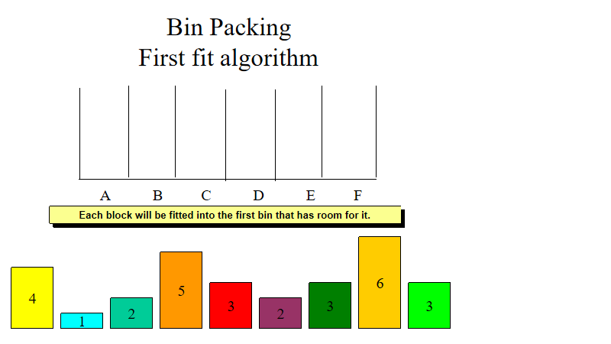

Slide 8
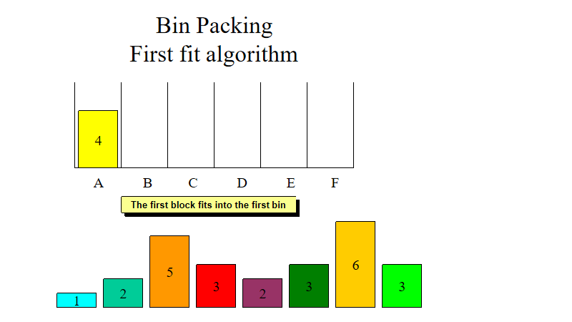

Slide 9
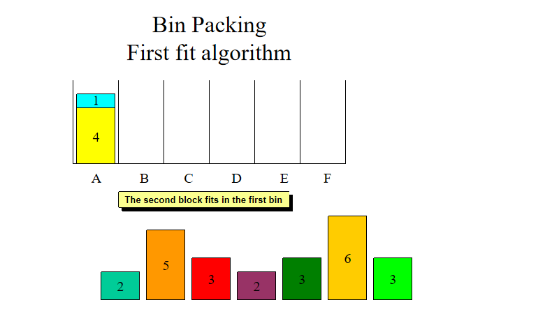

Slide 10
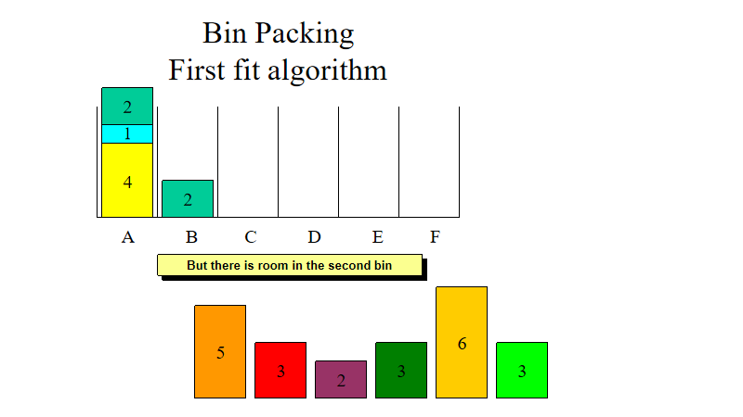

Slide 11
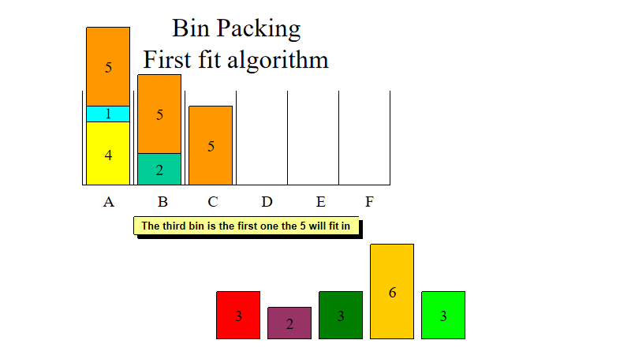

Slide 12
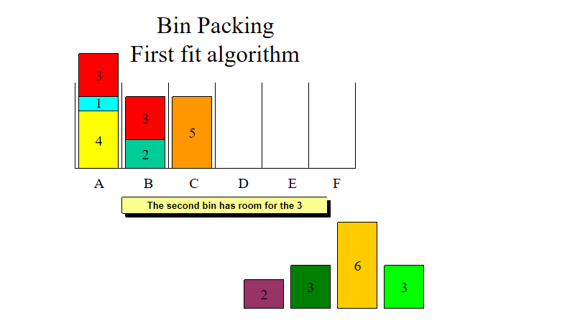

Slide 13
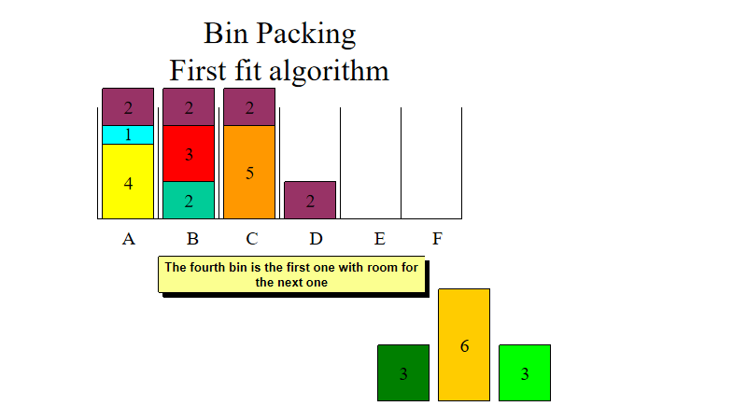

Slide 14
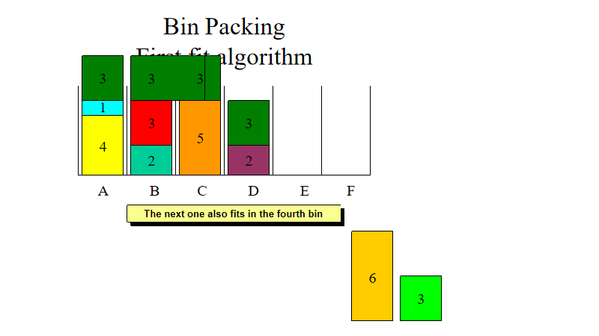

Slide 15
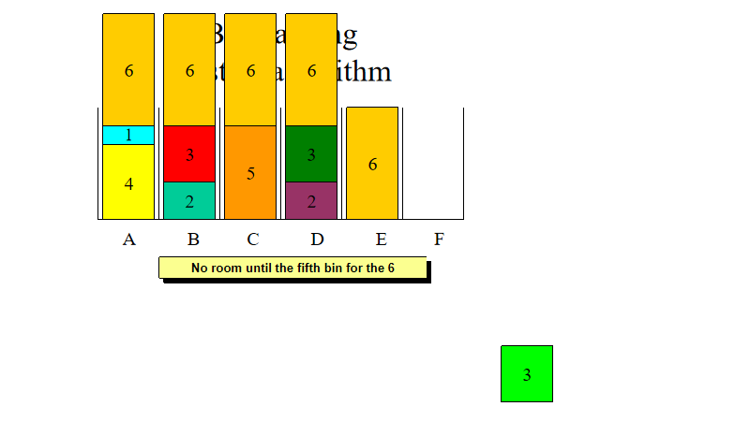

Slide 16
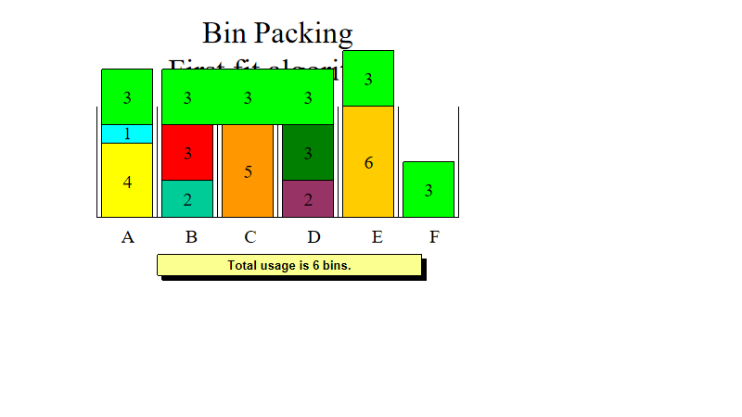

Slide 17
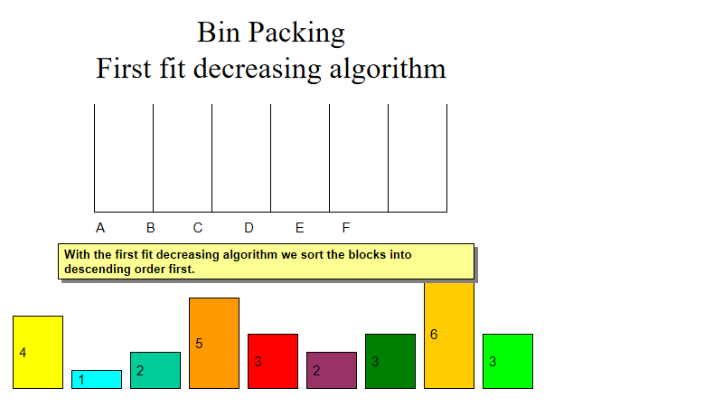

Slide 18
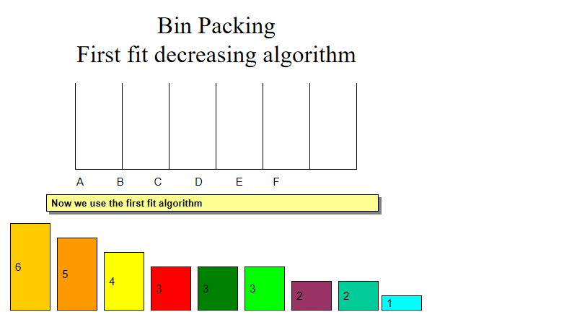

Slide 19
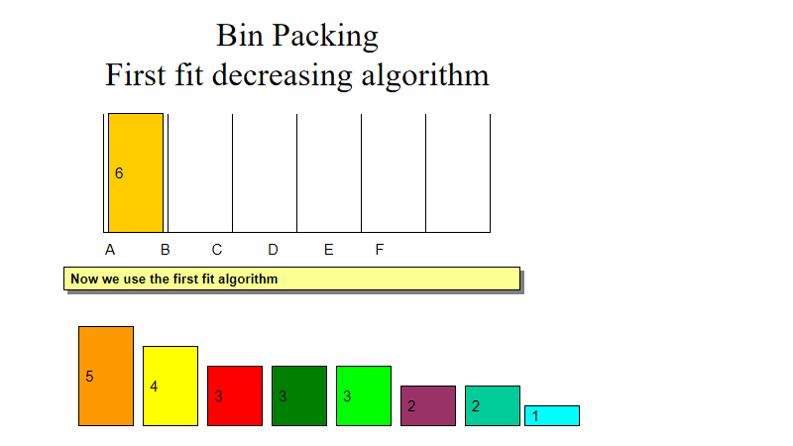

Slide 20
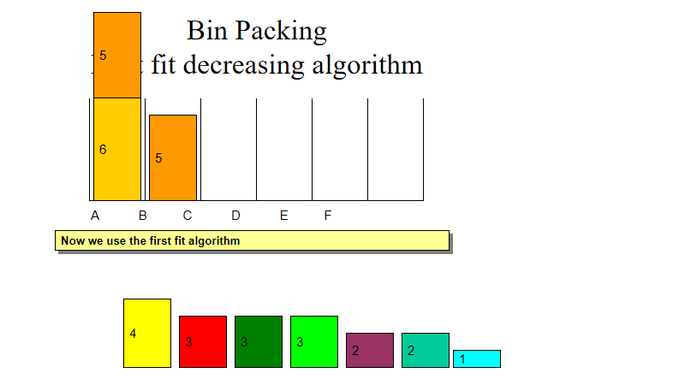

Slide 21
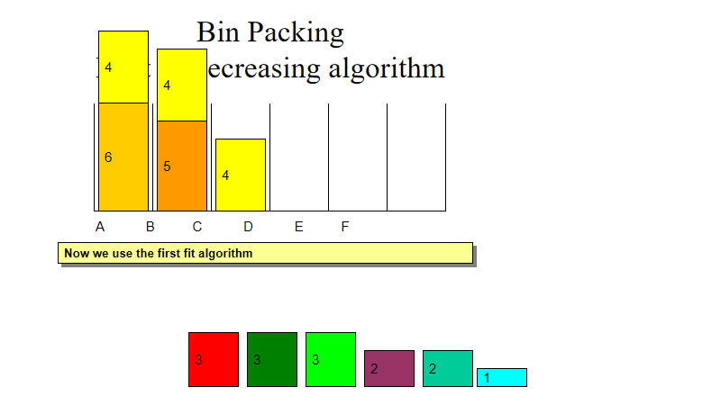

Slide 22
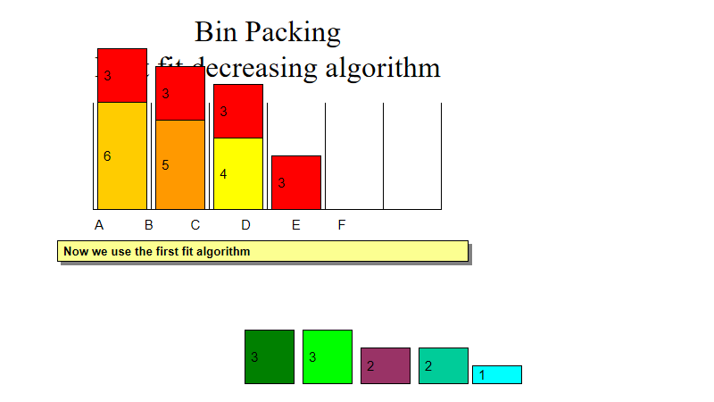

Slide 23
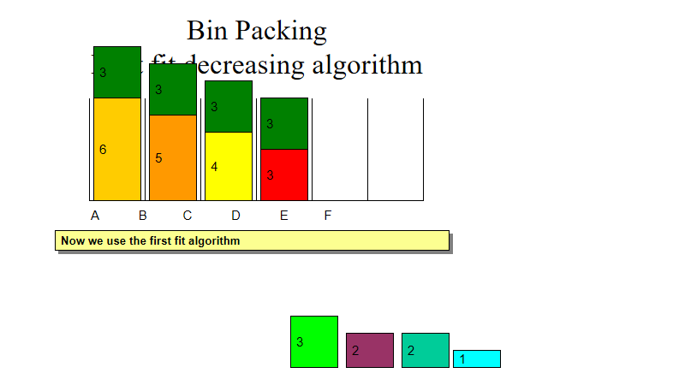

Slide 24
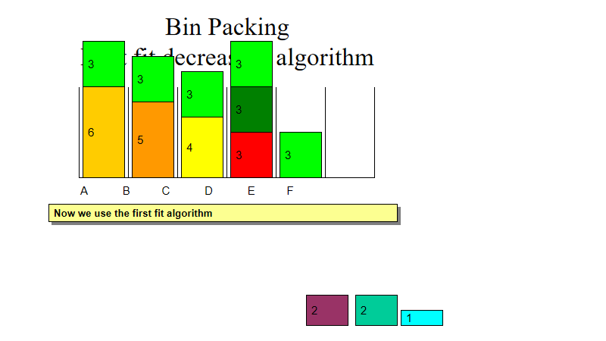

Slide 25
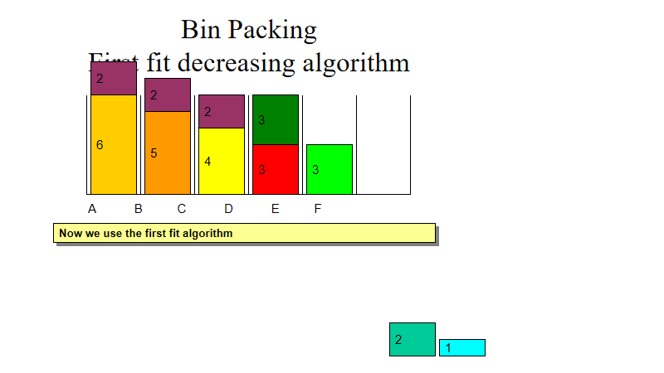

Slide 26
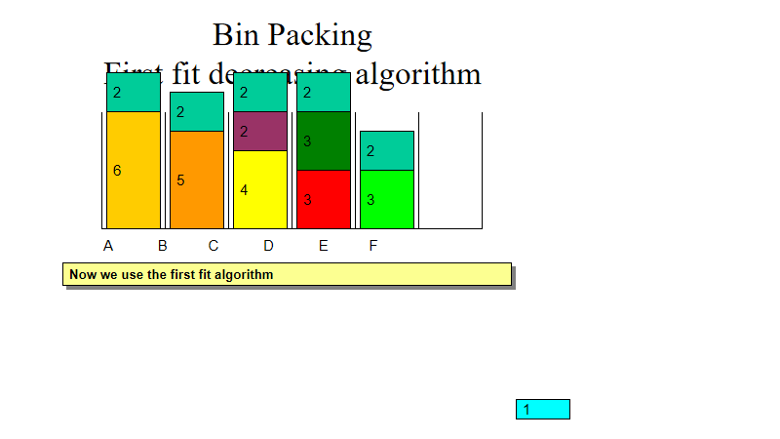

Slide 27
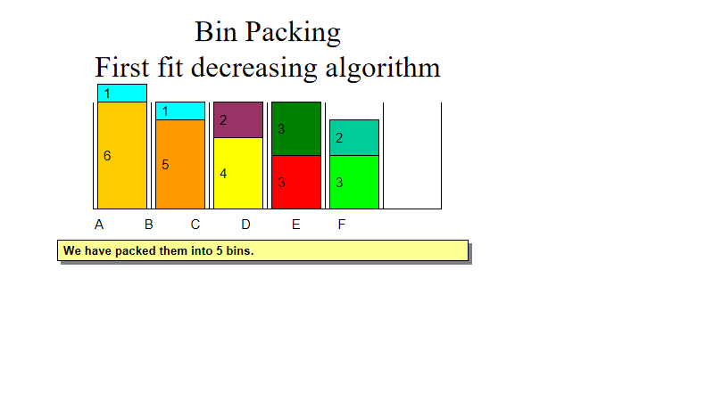

Slide 28
Thank you

